Slide 1
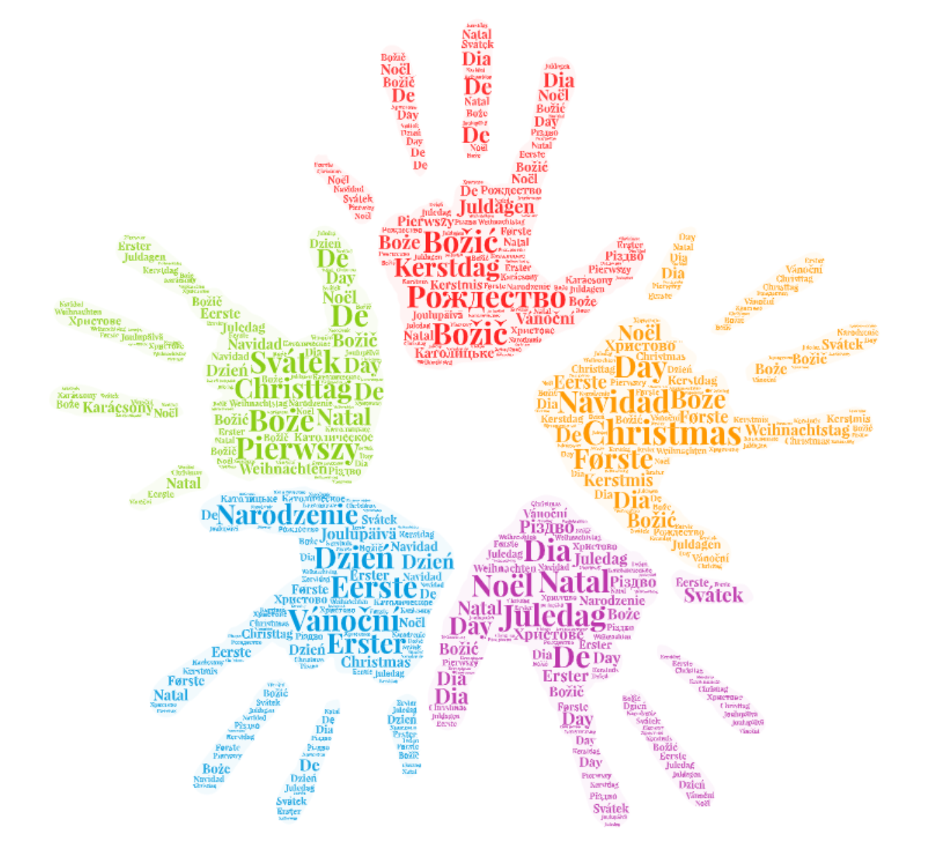

Merry Graphmas to Yule All!
Exploring Public Holiday Data Using Cosmos DB Gremlin API
Lightning talk for Cincinnati Software Craftsmanship Presented by: Sarah "sadukie" Dutkiewicz
Microsoft MVP, Developer Technologies
Word art generated at WordArt.com
Notes:
Join us for some festive lightning talks (and more!) during our End of Year Celebration on December 1st. Sarah "Sadukie" Dutkiewicz will show us how to explore the holidays with a graph database in her festive lightning talk “Merry Graphmas for Yule All!” We hope to see you there!

Slide 2
Graph Database + Christmas
Graphmas
Sadukie Celebrates Christmas

Slide 3
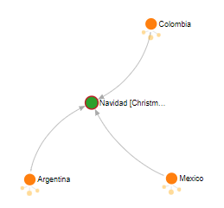
What is Graphmas?
[
{
"2021-12-01 00:00:00": 1,
"2021-12-05 00:00:00": 2,
"2021-12-06 00:00:00": 2,
"2021-12-08 00:00:00": 5,
"2021-12-12 00:00:00": 2,
"2021-12-16 00:00:00": 1,
"2021-12-19 00:00:00": 2,
"2021-12-24 00:00:00": 6,
"2021-12-25 00:00:00": 24,
"2021-12-26 00:00:00": 15,
"2021-12-27 00:00:00": 3,
"2021-12-28 00:00:00": 1,
"2021-12-31 00:00:00": 3
}
]
A celebration of December holidays as we explore the relationships between holidays and countries in a Graph database
Introducing:
Azure Open Datasets – specifically the Public Holidays dataset
Azure Cosmos DB Gremlin API

Slide 4
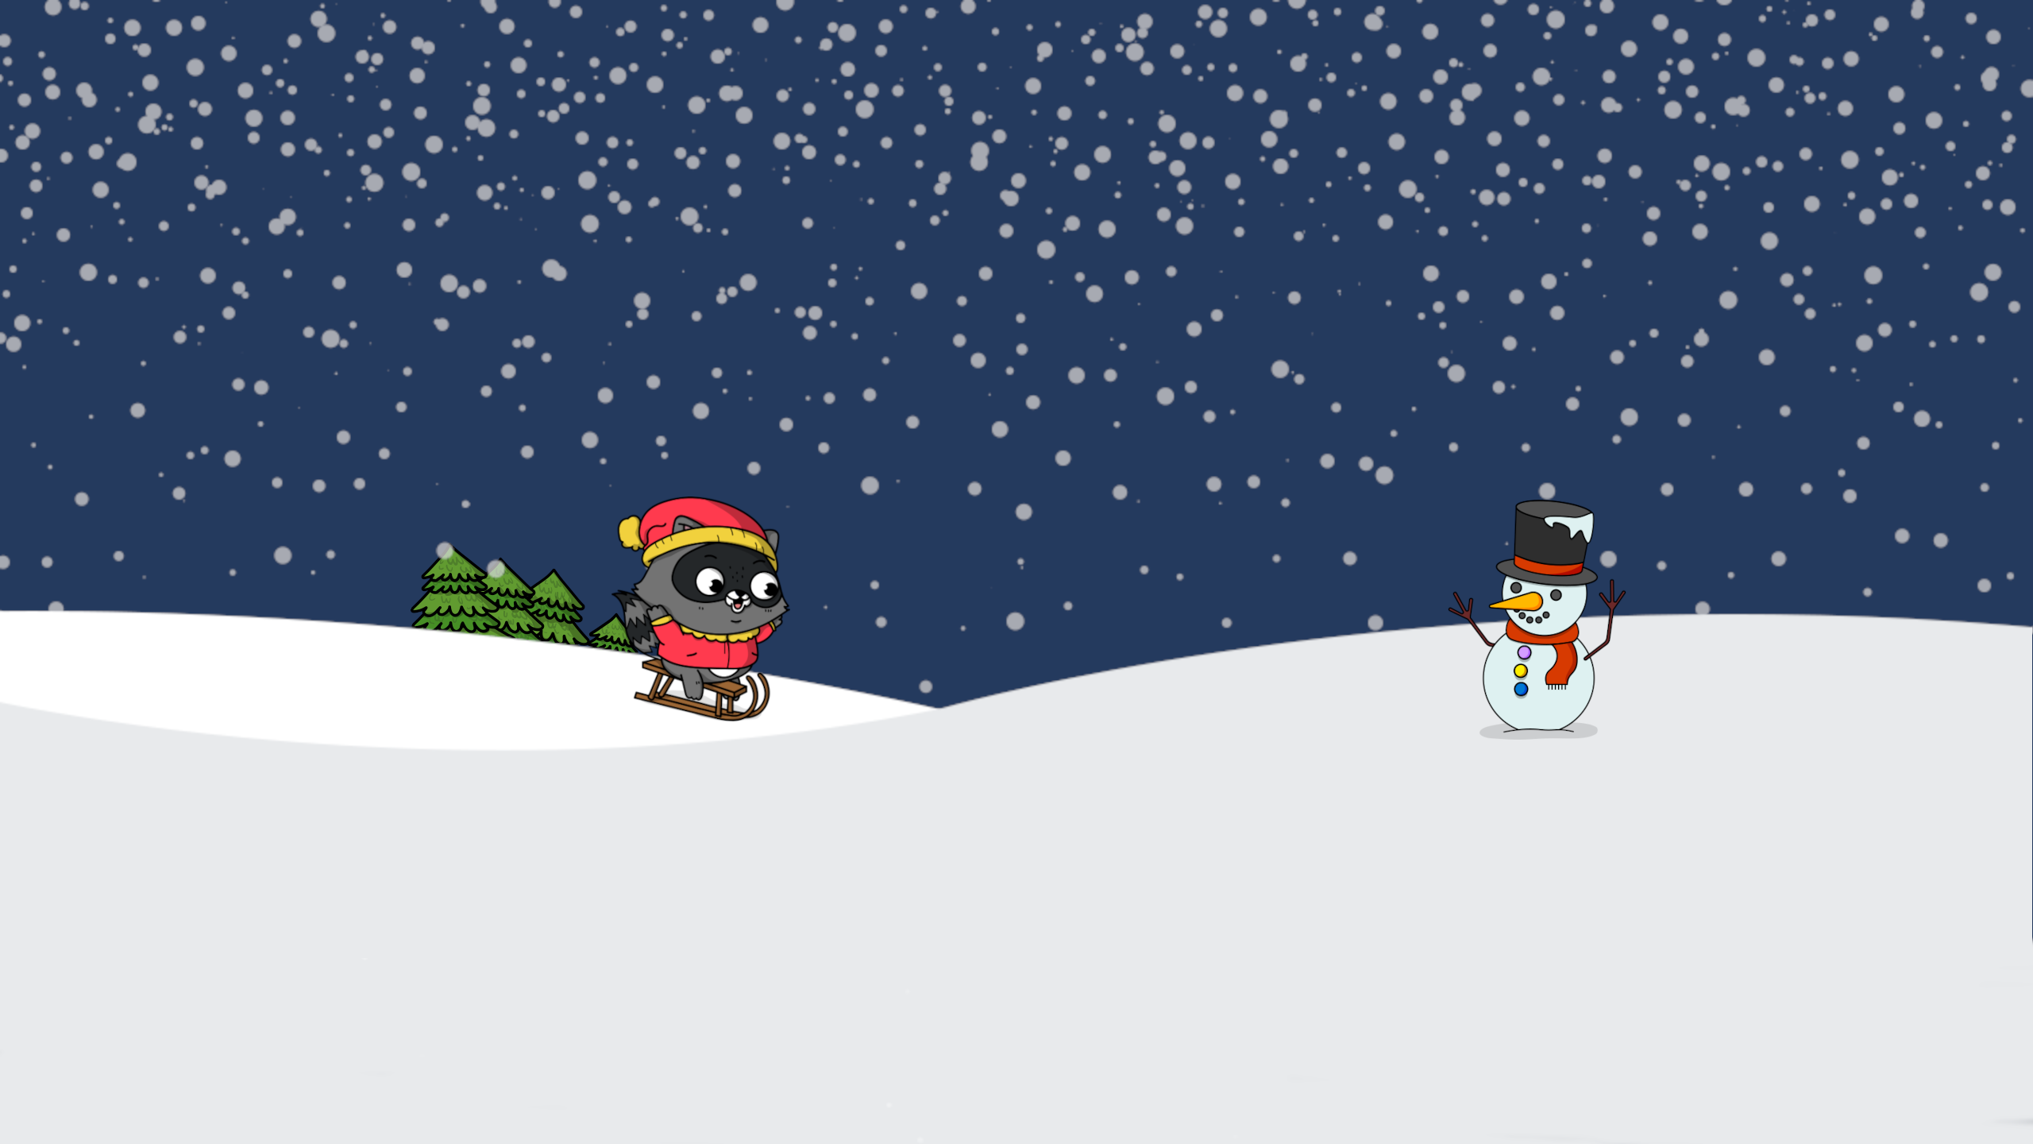
Lightning talks are FAST! Not all details are here!
Stay Tuned to
Festive Tech Calendar
for details!
https://festivetechcalendar.com

Slide 5


Azure Cosmos DB Gremlin API
Azure Cosmos DB is a multi-model database
Gremlin API - Graph database implementation in Azure Cosmos DB
Query in browser with Azure Data Explorer
Add to a graph with Azure Data Explorer
Build graphs with API libraries

Slide 6
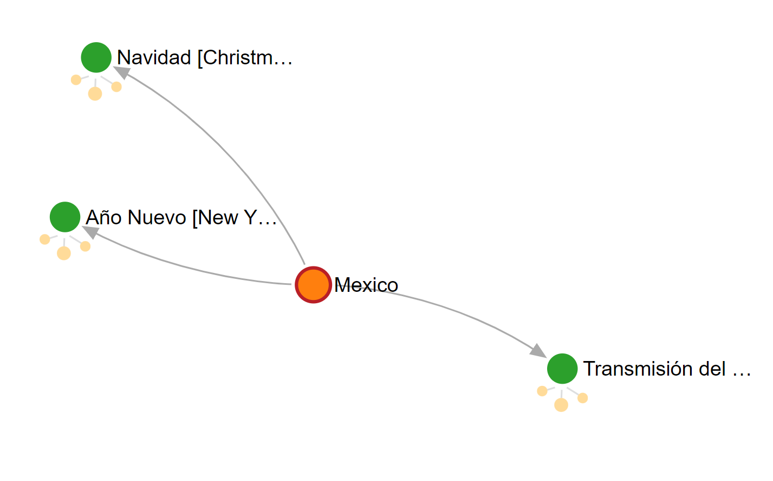
Key Concepts
Vertex – node – thing
Edge – arrows (directional) – relationships
Graph – collection of vertices and edges
Label – descriptor to identify type of vertex or type of edge

Slide 7
How did the Azure Open Dataset data get in Cosmos DB Gremlin API?
Loading the Database

Slide 8
Steps to Load
1. Create an Azure account (or log into your existing Azure account).
2. Create a Cosmos DB Gremlin API Azure resource.
3. Add a database named graphmas and a collection named holidays.
4. Download the starting Jupyter Notebook.
5. Update the connection details with your values.
6. Run the Jupyter Notebook to load the data into your Cosmos DB Gremlin API graphmas.holiday collection.

Slide 9
Loading the Database
# This is a package in preview.
from azureml.opendatasets import PublicHolidays
from datetime import datetime
end_date = datetime(2021,12,31)
start_date = datetime(2021,12,1)
hol = PublicHolidays(start_date=start_date, end_date=end_date)
…
# GraphSON V2 is called out here, as V3 is not supported yet
gremlin_client = client.Client(
'wss://' + ENDPOINT + ':443/', 'g',
username="/dbs/" + DATABASE + "/colls/" + COLLECTION,
password=PRIMARY_KEY,
message_serializer=serializer.GraphSONSerializersV2d0()
)
# Purge graph
cleanup_graph(gremlin_client)
# Insert vertices (nodes)
insert_vertices(gremlin_client)
# Insert edges (relationships)
insert_edges(gremlin_client)
Read in data using azureml-opendatasets in Python.
Azure Data Studio + Jupyter Notebook
Use gremlinpython to connect to Cosmos DB Gremlin API.
Create vertices for countries and holidays.
Countries are deduplicated by name.
Holidays are deduplicated by name and date.
Create edges for countries that celebrate holidays.
Can use to() and from() to build relationships. Direction matters.
Much like foreign keys in relational databases, both vertices need to exist
Download the loading Jupyter Notebook on GitHub: https://github.com/sadukie/graphmas/blob/main/Graphmas.ipynb

Slide 10
What’s an easy way to see graph data while querying it?
Azure Cosmos DB Gremlin API
+
Data Explorer

Slide 11
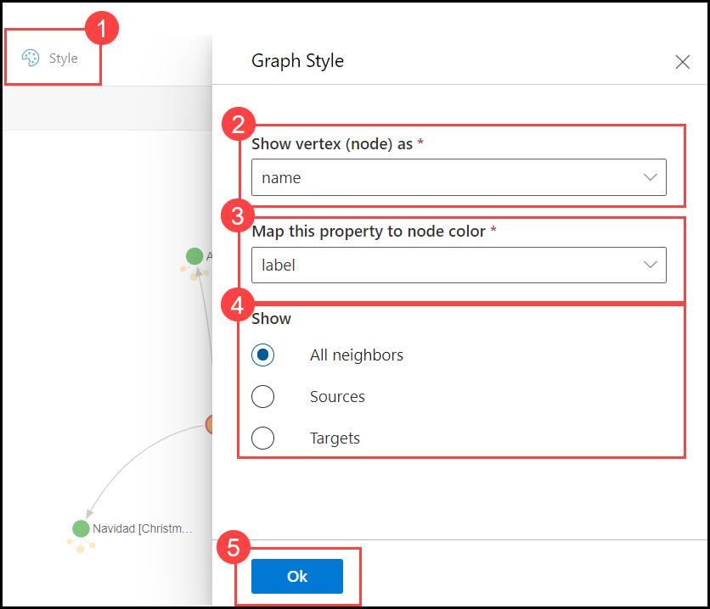
Setting the Graph Style in Azure Data Explorer
By default, the vertices display as ids. Let’s make them easier to read!

Slide 12
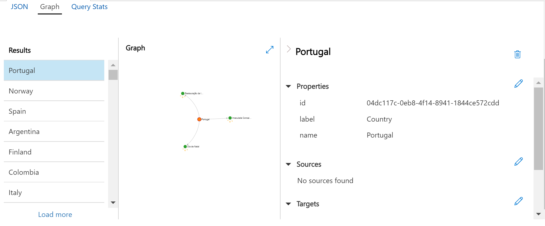
Azure Data Explorer – Cosmos DB Gremlin API

Slide 13
Can I get all the vertices? What about all the edges?
Basic Queries

Slide 14
Show all vertices
g.V()

Slide 15
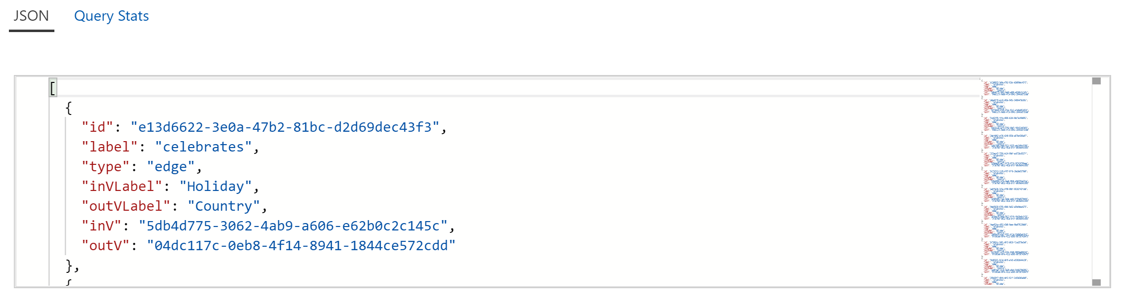
Show all edges
g.E()

Slide 16
How are the vertices and edges structured?
Learning about Labels and Properties

Slide 17
Show all unique labels for vertices
g.V().label().dedup()
[
"Country",
"Holiday"
]

Slide 18
Show all unique labels for edges
g.E().label().dedup()
[
"celebrates"
]

Slide 19
Show all properties for a Holiday vertex
[
{
"id": "5db4d775-3062-4ab9-a606-e62b0c2c145c|name",
"value": "Restauração da Independência",
"label": "name"
},
{
"id": "5d22ff45-4764-480e-bde8-58971823099a",
"value": "2021-12-01 00:00:00",
"label": "holidayDate"
}
]
g.V().hasLabel('Holiday') .limit(1) .properties()

Slide 20
Show all properties for a Country vertex
[
{
"id": "04dc117c-0eb8-4f14-8941-1844ce572cdd|name",
"value": "Portugal",
"label": "name"
}
]
g.V().hasLabel(Country') .limit(1) .properties()

Slide 21
Show a 'celebrates' edge
[
{
"id": "e13d6622-3e0a-47b2-81bc-d2d69dec43f3",
"label": "celebrates",
"type": "edge",
"inVLabel": "Holiday",
"outVLabel": "Country",
"inV": "5db4d775-3062-4ab9-a606-e62b0c2c145c",
"outV": "04dc117c-0eb8-4f14-8941-1844ce572cdd"
}
]
g.E().hasLabel('celebrates') .limit(1)
Edges could have properties. This sample doesn't have that.

Slide 22
Tell me more in this dataset
Learning About the Dataset

Slide 23
How many Holiday vertices?
g.V().hasLabel('Holiday').count()
[
67
]

Slide 24
How many Country vertices?
g.V().hasLabel('Country').count()
[
37
]

Slide 25
How many edges?
g.E().count()
[
107
]

Slide 26
How many vertices have the holidayDate property?
g.V().has('holidayDate').count()
[
67
]

Slide 27
How many vertices do not have the holidayDate property?
g.V().hasNot('holidayDate').count()
[
37
]

Slide 28
Showing count of holidays grouped by date
[
{
"2021-12-01 00:00:00": 1,
"2021-12-05 00:00:00": 2,
"2021-12-06 00:00:00": 2,
"2021-12-08 00:00:00": 5,
"2021-12-12 00:00:00": 2,
"2021-12-16 00:00:00": 1,
"2021-12-19 00:00:00": 2,
"2021-12-24 00:00:00": 6,
"2021-12-25 00:00:00": 24,
"2021-12-26 00:00:00": 15,
"2021-12-27 00:00:00": 3,
"2021-12-28 00:00:00": 1,
"2021-12-31 00:00:00": 3
}
]
g.V().hasLabel('Holiday')
.group().by('holidayDate')
.by(values('name').count())

Slide 29
Get the holidays ordered by date, then name
[
{
"name": [
"Restauração da Independência"
],
"holidayDate": [
"2021-12-01 00:00:00"
]
},
… {
"name": [
"Año Nuevo [New Year's Day]"
],
"holidayDate": [
"2021-12-31 00:00:00"
]
},
{
"name": [
"New Year's Day"
],
"holidayDate": [
"2021-12-31 00:00:00"
]
},
{
"name": [
"Nyårsafton"
],
"holidayDate": [
"2021-12-31 00:00:00"
]
}
]
g.V().hasLabel('Holiday')
.order()
.by('holidayDate')
.by('name')
.valueMap('name','holidayDate')

Slide 30
How do we follow these paths?
Graph Traversal

Slide 31
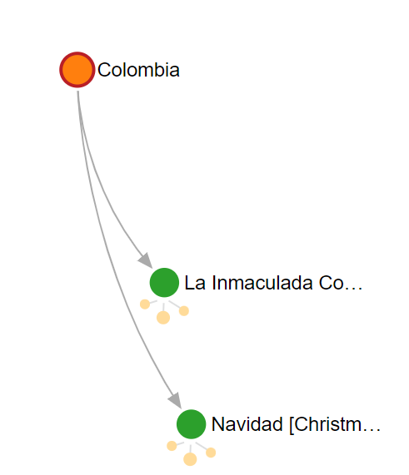
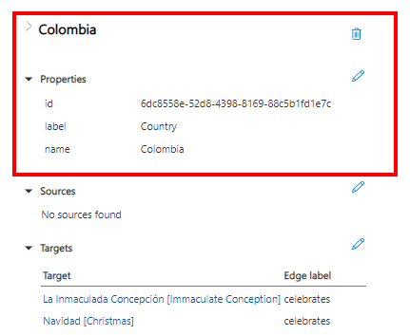
Show holidays for Colombia
g.V().has('name','Colombia')

Slide 32
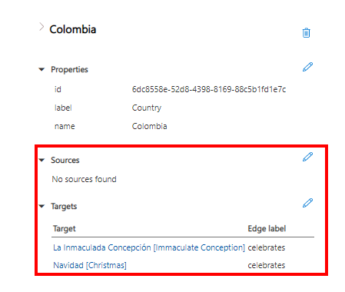
Show all edges for Colombia
g.V().has('name','Colombia').bothE()

Slide 33
Get the names for holidays celebrated by Colombia
g.V().has('name','Colombia')
.outE('celebrates')
.inV()
.values('name')
[
"La Inmaculada Concepción [Immaculate Conception]",
"Navidad [Christmas]"
]

Slide 34
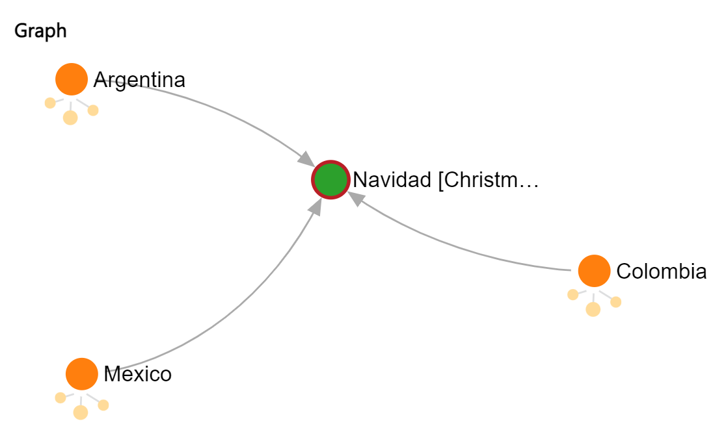
Mexico and Colombia share a holiday
g.V().has('name','Colombia')
.outE()
.inV()
.inE()
.outV()
.has('name','Mexico')

Slide 35
Mexico and Colombia share a holiday – show the path
g.V().has('name','Colombia')
.outE()
.inV()
.inE()
.outV()
.has('name','Mexico')
.path()

Slide 36
Mexico and Colombia share a holiday – show the execution profile
g.V().has('name','Colombia')
.outE()
.inV()
.inE()
.outV()
.has('name','Mexico')
.executionprofile()
[
{
"gremlin": "g.V().has('name','Colombia')
.outE()
.inV()
.inE()
.outV()
.has('name','Mexico')
.executionprofile()",
"activityId": "3e1db2dc-bea2-4aa4-8e52-
a47538340ade",
"totalTime": 28,
"totalResourceUsage": 16.36,
"metrics": [
…
]
}
]

Slide 37
Execution Profile Metrics
Many of these include times, counts, and storage details.
For this query:
GetVertices
Get Edges
GetNeighborVertices
GetEdges
GetNeighborVertices
FilterInBatchOperator
ProjectOperator
g.V().has('name','Colombia')
.outE()
.inV()
.inE()
.outV()
.has('name','Mexico')
.executionprofile()

Slide 38
So many relationships to explore!
This sounds cool! Can we learn more?

Slide 39
Additional Resources
Azure Cosmos DB Cheat Sheets
Azure Cosmos DB Gremlin graph support and compatibility with TinkerPop features
Practical Gremlin: An Apache TinkerPop Tutorial by Kelvin R. Lawrence
Gremlin Cheat Sheet by Daniel Kuppitz

Slide 40
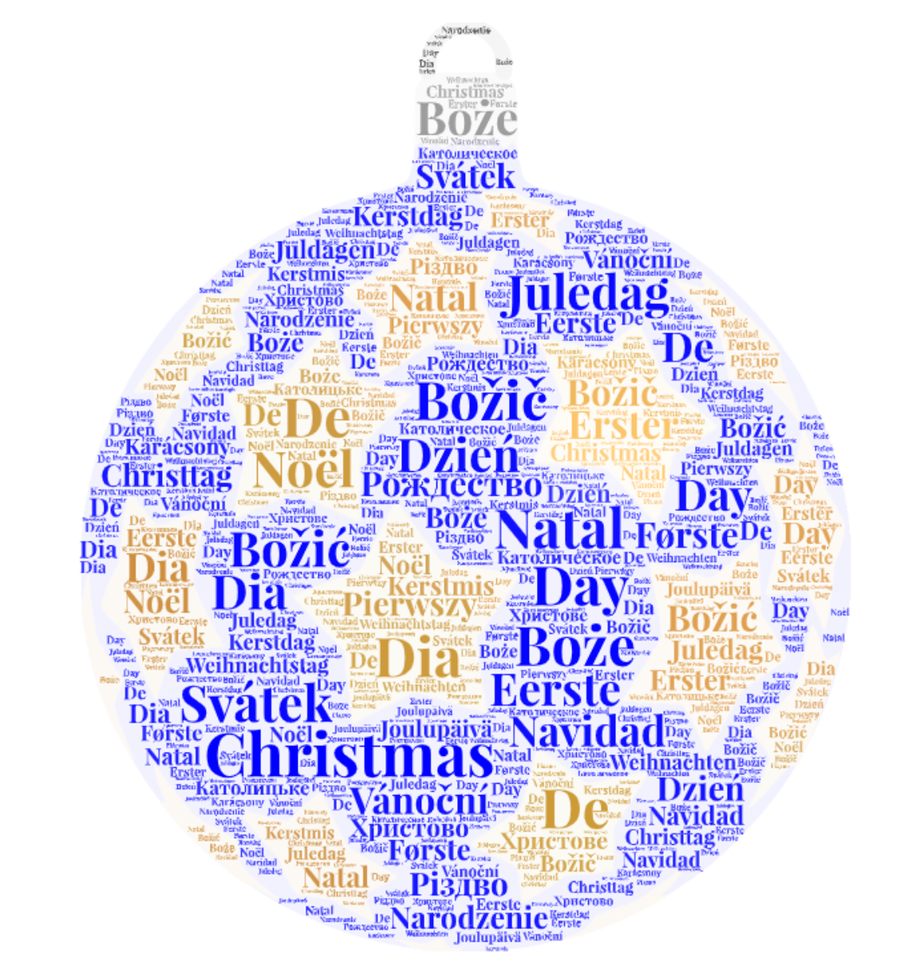

Merry Graphmas to Yule All!
Wishing you a festive holiday season!
Connect with me at https://linkedin.com/in/sadukie
Twitter: @sadukie
Word art generated at WordArt.com
https://festivetechcalendar.com
Notes:
Word art generated at WordArt.com

